Slide 1
GasCore+ Inception
Team 5
Team Members: Abbinav H. Burhanuddin C. Dhairya C. Ritesh M.
CSE 6324-001

Slide 2
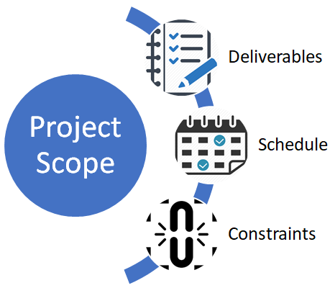
Project Vision
Static/Dynamic Analysis
GasGauge
Identifies Gas Related Vulnerabilities
Symbolic Execution
MantiCore
Program Exploration, Input Generation
Our New Tool
GasCore+
Gas Gauge + MantiCore
GitHub Repository
Link: GitHub - Abbinav/CSE-6324-Team5: GasCore+ Implementation
Version: 0.1
[11]

Slide 3

Customers & Users
Customers:
Dr. Christopher Csallner
Provide Team Assistance and Project Feedback (Written Deliverables & Project Repo).
GTA Mohammed Rifat
Provide Team Assistance and Project Feedback (Written Deliverables & Project Repo).
Shovon Niverd Pereira
Team Collaborator for Ethereum Smart Contracts.
Review Team 6 Members
Provide Project Feedback per Iteration (Written Deliverables & Code Review).
Users:
Class of CSE 6324-001
Team’s Target Audience and Possible Future Users of the Tool.
[3]

Slide 4

Features/User Stories
[16]
How is GasCore+ different?
GasCore+ = Static Analysis + Dynamic Analysis + Symbolic Execution.
Type Of User | Benefits
End User/Customer | Save Gas(Ethereum)
Developer | Good Product
Owner of a Company | Maintain the Trust
Tester/Smart contract Executer | Deploying the right program on EVM

Slide 5


Software Development Plan - 1st Iteration
Features of GasGauge and MantiCore selected for implementation.
Each team member gets assigned a part of development.
Start towards developing the first prototype.
Software Development Plan - 2nd Iteration
Working first prototype in hand.
Decide which features implemented are not necessary for GasCore+.
Pick any additional functionality needed and work towards its implementation.
[13]
[14]

Slide 6

Software Development Plan - 3rd Iteration
Start Testing of GasCore+.
Choose publicly available smart contracts and perform static analysis, dynamic analysis and symbolic execution individually using GasCore+.
Software Development Plan - 4th Iteration
Complete the development of GasCore+
Perform all required tests and resolve any issues that arise
Prepare GasCore+ for final presentation and review
[15]

Slide 7
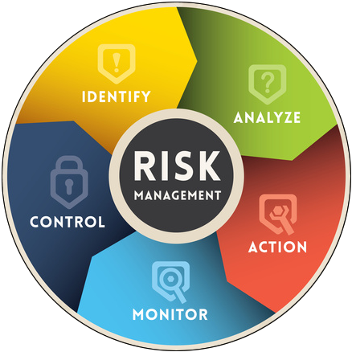
Risk Management Plan
Top 3 Risks List
Technical Risk
Attempt to combine two separate programs.
Possible Issues with compilation, running, producing similar results.
Resource Risk
Team not familiar with Ethereum Smart Contracts.
Availability of Open Source Smart Contracts.
Schedule Risk
Team will have scheduling issues with other classes’ assignments/projects.
Constraint
Scheduled Delivery Date
Written deliverables, presentations, and repo checks.
Ready to submit at the end of each Iteration.
[1]

Slide 8
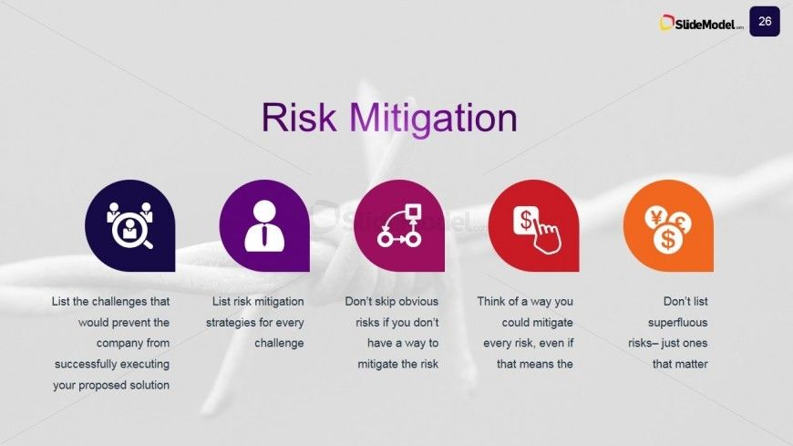
Risk Management Plan
Mitigation Plan
Technical Risk Mitigation
Understand code structure of both tools.
Find best place to combine both tool’s Python code with Python expert’s assistance.
Resource Risk Mitigation
Team members research Ethereum Smart Contracts in more depth.
Receive assistance from Shovon for finding Open Source Smart Contracts.
Schedule Risk Mitigation
Team will remain flexible to take on extra tasks.
Team will communicate issues/concerns through Microsoft Teams
[2]

Slide 9
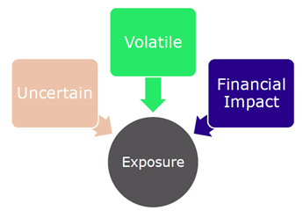
Risk Management Plan
Risk Exposure
Technical Risk
Probability of Risk Occurring (PR) = 50%
Effect of Risk Occurring (ER) = 10 hours will be spent
Risk Exposure (RE) = 5.0 extra hours
Resource Risk
Probability of Risk Occurring (PR) = 30%
Effect of Risk Occurring (ER) = 8 hours will be spent
Risk Exposure (RE) = 2.4 extra hours
Schedule Risk
Probability of Risk Occurring (PR) = 25%
Effect of Risk Occurring (ER) = 4 hours will be spent
Risk Exposure (RE) = 1.0 extra hours
[4]

Slide 10
Competitors
Tool Name | Method
GasCore+ | Static + Dynamic Analysis + Symbolic Execution
GasGauge | Static + Dynamic Analysis
MantiCore | Symbolic Execution
MPro | Static Analysis + Symbolic Execution
Slither | Static Analysis
Mythril | Symbolic Execution

Slide 11
References
[1] Risk Mitigation Plan Case Studies Slide Design - SlideModel | Case study template, Case study, Management infographic (pinterest.com), accessed 09/11/2022
[2] The Benefits of Risk Management Planning – Bellevue University Project Management Center of Excellence, accessed 09/11/2022
[3] ICEFLO | ScreenSteps, accessed 09/11/2022
[4] Risk Assessment Analysis: Exposure and Target Accounts for Risk Hedging - FinanceTrainingCourse.com, accessed 09/11/2022
[5] Bistarelli, S., Mazzante, G., Micheletti, M., Mostarda, L., Sestili, D., & Tiezzi, F. (2020). Ethereum smart contracts: Analysis and statistics of their source code and opcodes. Internet of Things,
[6] Ashraf, I., Ma, X., Jiang, B., & Chan, W. K. (2020). GasFuzzer: Fuzzing Ethereum Smart Contract Binaries to Expose Gas-Oriented Exception Security Vulnerabilities. [7] (2020, March 19). Crypto Market Pool - Gas in Solidity smart contracts. Crypto Market Pool. https://cryptomarketpool.com/gas-in-solidity-smart-contracts/, accessed 09/11/2022
[8] W. Zhang, S. Banescu, L. Pasos, S. Stewart and V. Ganesh, "MPro: Combining Static and Symbolic Analysis for Scalable Testing of Smart Contract," in 2019

Slide 12
References
[9] Mark Mossberg, Felipe Manzano, Eric Hennenfent, Alex Groce, Gustavo Grieco, Josselin Feist, Trent Brunson, and Artem Dinaburg. 2019. Manticore: a user-friendly symbolic execution framework for binaries and smart contracts
[10] Liu, Y., Xu, J., Cui, B. (2022). Smart Contract Vulnerability Detection Based on Symbolic Execution Technology. In: Lu, W., Zhang, Y., Wen, W., Yan, H., Li, C. (eds) Cyber Security
[11] https://www.cprime.com/wp-content/uploads/2020/09/Untitled-3.png, Accessed 09/11/2022
[12] https://lightrains.com/blogs/solidity-static-analysis-tools/ , Accessed 09/10/2022
[13] https://www.wdpi.com/about/company-info/hardware-lifecycle-management ,Accessed 09/11/2022
[14] https://thenounproject.com/browse/icons/term/prototype/?iconspage=1 ,Accessed 09/11/2022
[15] https://www.needpix.com/photo/378363/software-testing-service-bugs-search-it ,Accessed 09/11/2022
[16] https://stormotion.io/blog/how-to-write-a-good-user-story-with-examples-template, Accessed 09/11/2022

Slide 13
Thank You!
Questions?

